Slide 1
Dataset on heart disease
Sanjeeb Adhikari

Slide 2
Dataset overview
Dataset Description: This dataset contains information about heart disease patients from Switzerland, including demographic, clinical, and diagnostic attributes.
Source: UCI Heart Disease Dataset.

Slide 3
Dataset Description
Field Name | Description | Data Type
age | Patient’s age | Integer
sex | Gender of the patient (1 = male, 0 = female) | Categorical
cp | Chest pain type (1 = typical angina, 2 = atypical angina, 3 = non-anginal pain, 4 = asymptomatic) | Categorical
trestbps | Resting blood pressure (in mm Hg) | Integer
chol | Serum cholesterol level (in mg/dl) | Integer
fbs | Fasting blood sugar > 120 mg/dl (True/False) | Boolean
restecg | Resting electrocardiographic results (0 = normal, 1 = having ST-T wave abnormality, 2 = showing probable or definite left ventricular hypertrophy) | Categorical
thalach | Maximum heart rate achieved | Integer
exang | Exercise-induced angina (True/False) | Boolean
oldpeak | ST depression induced by exercise relative to rest | Numeric
slope | Slope of the peak exercise ST segment (1 = upsloping, 2 = flat, 3 = downsloping) | Categorical
ca | Number of major vessels (0-3) colored by fluoroscopy | Integer
thal | Thalassemia type (3 = normal, 6 = fixed defect, 7 = reversible defect) | Categorical
num | Diagnosis of heart disease (target variable: 0 = no disease, 1-4 = presence of disease) | Integer

Slide 4
Well-Defined Machine Learning Problem
Goal: Predict the presence of heart disease (target variable: num) using patient demographic, clinical, and diagnostic attributes. It will help in early prediction of heart diseases and improve diagnostic accuracy.
Problem Type: Binary classification problem.

Slide 5
Sketch of Machine Learning Solution
Workflow Diagram: Include the following steps:
Data Collection: Finding dataset and load it to PostgreSQL
Data Ingestion: Load data from PostgreSQL.
Data Preprocessing: Handle missing values, normalize features, and encode categorical variables.
Model Training: Train models like Logistic Regression, Decision Tree, or Random Forest.
Model Evaluation: Use metrics such as accuracy, precision, recall, and F1-score.
Prediction: Apply the model to new data.

Slide 6
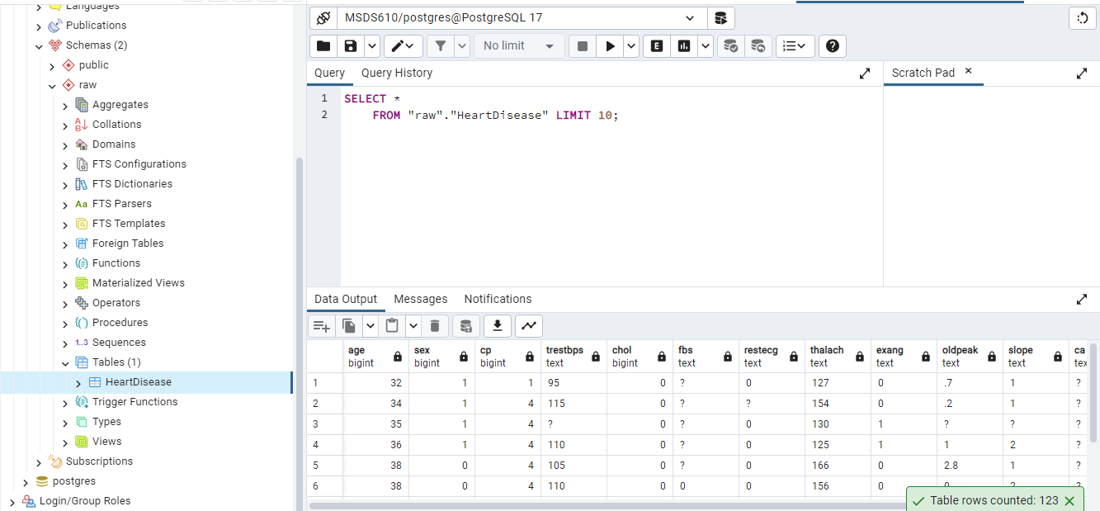
Loaded DATA

